Slide 1
A Research on Text Vector Representations and Modelling based on Neural Networks
L.-Q. NIU
20/4/2016

Slide 2
Outline
Background
Related Work
Traditional text representations
Distributed representations
My Work
Motivations
Learning Distributed Representations of Topics
A Unified Learning Framework for Words and Attributes
Embedding Enhanced Topic Models
Conclusions
Reference

Slide 3
Outline
Background
Related Work
Traditional text representations
Distributed representations
My Work
Motivations
Learning Distributed Representations of Topics
A Unified Learning Framework for Words and Attributes
Embedding Enhanced Topic Models
Conclusions
Reference

Slide 4
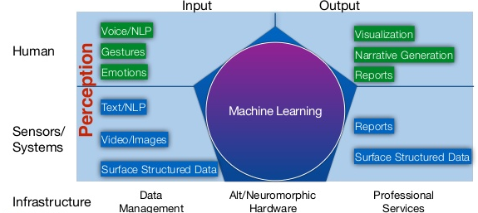
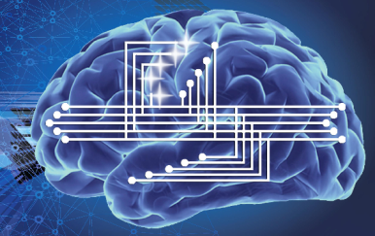
Background
Modern AI Systems
Perception: image/speech recognition, text understanding, etc.
Cognition: inference, reasoning, decision-making, etc.

Slide 5
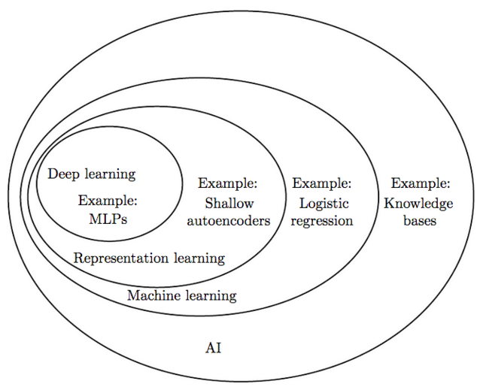
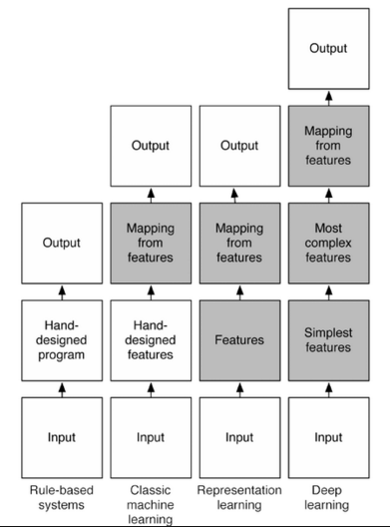
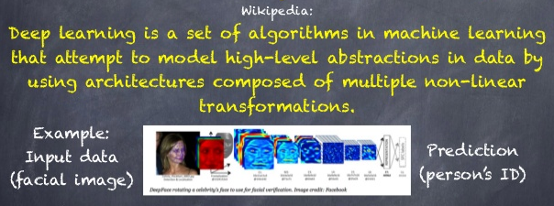
Background
Machine Learning and Deep Learning

Slide 6
Background
Deep Learning for Natural Language Processing (NLP)
The need for distributed representations
Distributed representations deal with the curse of dimensionality
Unsupervised feature and weight learning
Learning multiple levels of representation
Handling the recursivity of human language
Deep Learning models have already achieved impressive results
LM, NER, POS-Tagging, Chunking, SA, etc.

Slide 7
Outline
Background
Related Work
Traditional text representations
Distributed representations
My Work
Motivations
Learning Distributed Representations of Topics
A Unified Learning Framework for Words and Attributes
Embedding Enhanced Topic Models
Conclusions
Reference

Slide 8
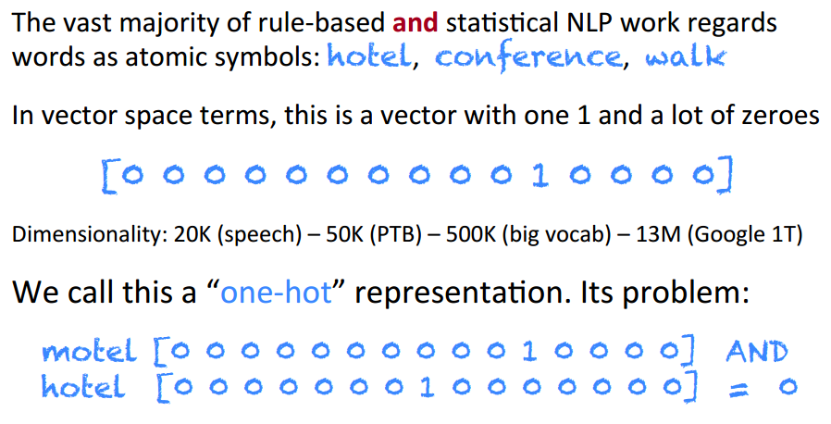
Traditional text representations
The standard word representation
Bag-of-Words (BOW)

Slide 9
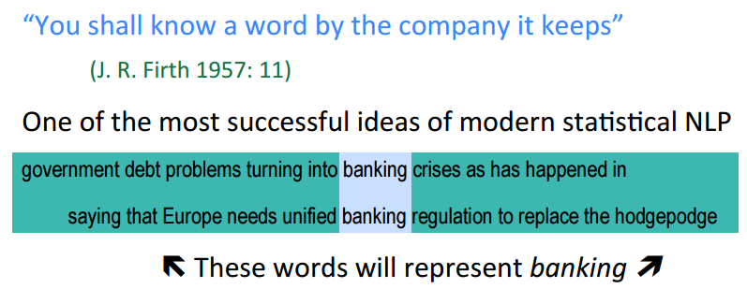
Traditional text representations
Distributional similarity based representations
Distributional representations
Latent Semantic Analysis (LSA), LSI, PLSA
Latent Dirichlet Allocation (LDA)
Hyperspace Analogue to Language (HAL)
Clustering-based word representations

Slide 10
Outline
Background
Related Work
Traditional text representations
Distributed representations
My Work
Motivations
Learning Distributed Representations of Topics
A Unified Learning Framework for Words and Attributes
Embedding Enhanced Topic Models
Conclusions
Reference

Slide 11
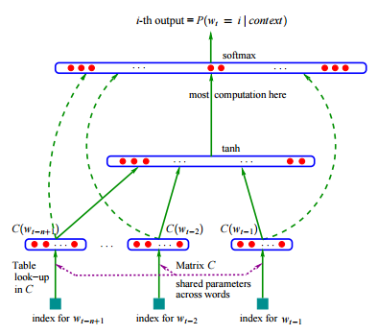
Distributed representations
Neural Probabilistic Language Models (NPLMs)
learns simultaneously (1) a distributed representation for each word along with (2) the probability function for word sequences, expressed in terms of these representations.

Slide 12
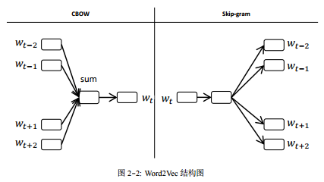


Distributed representations
Neural word embeddings as a distributed representation
Word2Vec
CBOW
Skip-gram
Optimization
Hierarchical softmax
Negative sampling
SGD

Slide 13
Outline
Background
Related Work
Traditional text representations
Distributed representations
My Work
Motivations
Learning Distributed Representations of Topics
A Unified Learning Framework for Words and Attributes
Embedding Enhanced Topic Models
Conclusions
Reference

Slide 14
Outline
Background
Related Work
Traditional text representations
Distributed representations
My Work
Motivations
Learning Distributed Representations of Topics
A Unified Learning Framework for Words and Attributes
Embedding Enhanced Topic Models
Conclusions
Reference

Slide 15

Motivations
Perception tasks: image/speech recognition, text understanding, etc.
Deep learning: RBM, CNN, RNN, AE, etc.
Cognitive tasks: inference, reasoning, decision-making, etc.
Bayesian graphical models: LDA, PMF, etc.
Naturally, to integrate deep learnings and Bayesian models

Slide 16
Motivations
Extending Word2Vec and LDA
Topic2Vec: Learning Distributed Representations of Topics, IALP 2015
A Unified Framework for Jointly Learning Distributed Representations of Word and Attributes, ACML 2015
Integrating Word2Vec and LDA
Word Embedding Enhanced Topic Models

Slide 17
Outline
Background
Related Work
Traditional text representations
Distributed representations
My Work
Motivations
Learning Distributed Representations of Topics
A Unified Learning Framework for Words and Attributes
Embedding Enhanced Topic Models
Conclusions
Reference

Slide 18
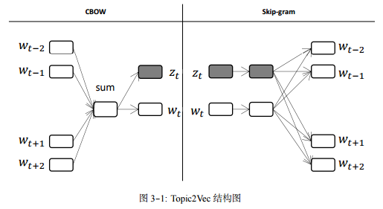
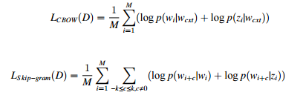
Learning Distributed Representations of Topics
Topic2Vec
CBOW
Skip-gram
Optimization
Negative sampling
SGD

Slide 19
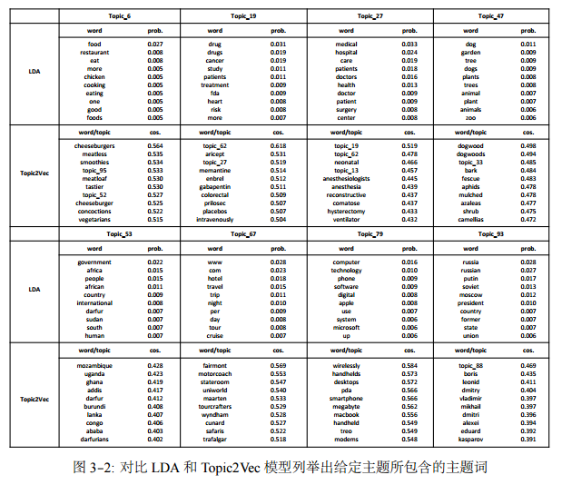
Learning Distributed Representations of Topics
Experiment
Topic words

Slide 20
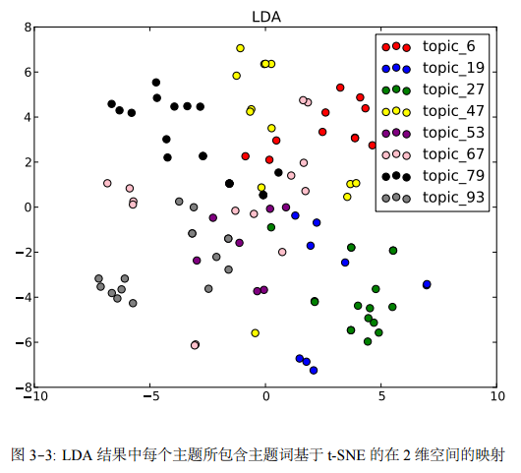
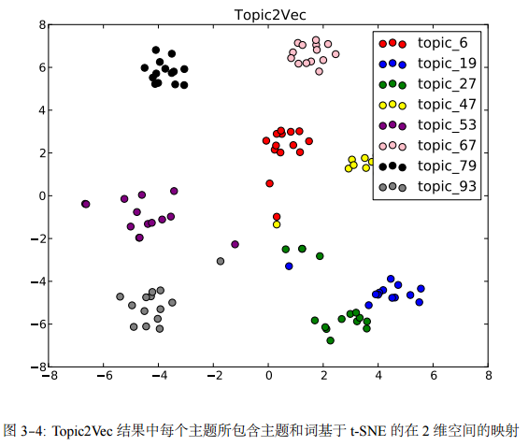
Learning Distributed Representations of Topics
Experiment: t-SNE 2D embedding

Slide 21
Learning Distributed Representations of Topics
Summary
Topic2Vec: learning distributed topic representations
LDA: representing topic as probability distribution over words
Distributed topic representations perform better than distributional topic representations

Slide 22
Outline
Background
Related Work
Traditional text representations
Distributed representations
My Work
Motivations
Learning Distributed Representations of Topics
A Unified Learning Framework for Words and Attributes
Embedding Enhanced Topic Models
Conclusions
Reference

Slide 23
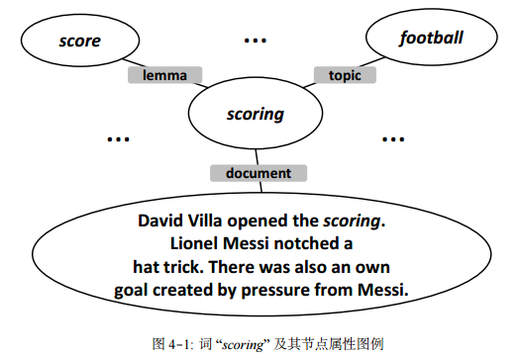
A Unified Learning Framework for Words and Attributes
Embeddings beyond word level
Phrases and sentences
Entities and relations
Social and citation networks
Words occur with attributes
POS-Tag, lemma
Phrase, sentence
Language
Sentiment
Name

Slide 24
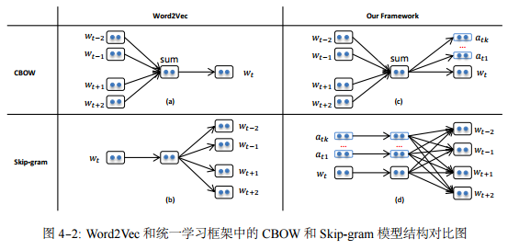
A Unified Learning Framework for Words and Attributes
The need for a unified framework for jointly learning distributed representations of word and attributes

Slide 25
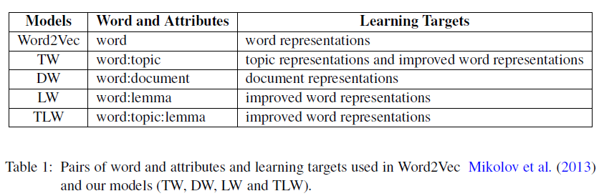
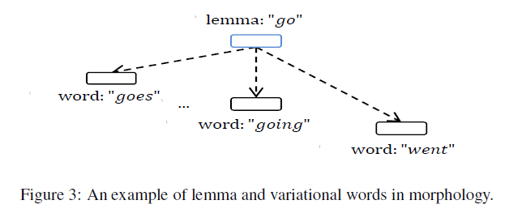
A Unified Learning Framework for Words and Attributes
Models

Slide 26
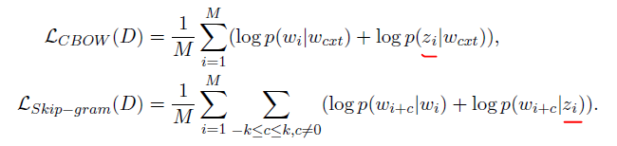
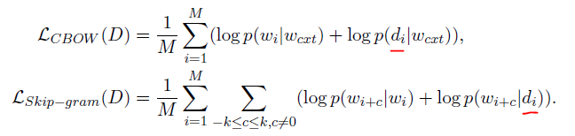
A Unified Learning Framework for Words and Attributes
TW: Learning Topic Representations
DW: Learning Document Representations

Slide 27
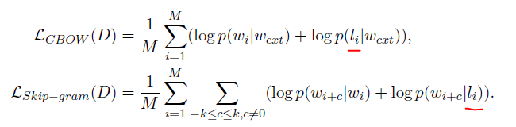
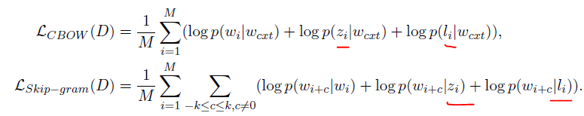
A Unified Learning Framework for Words and Attributes
Improving Word Representations
LW
TLW

Slide 28
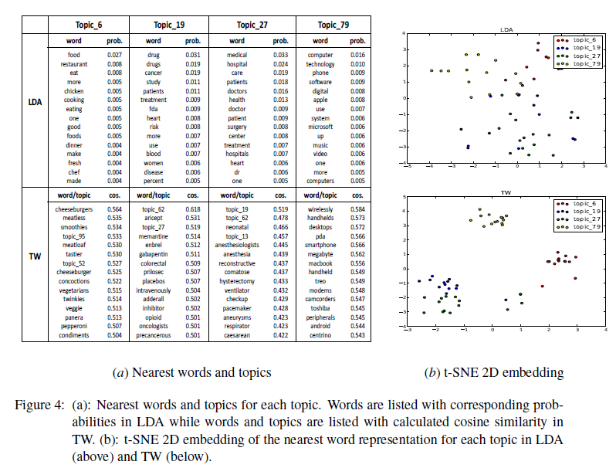
A Unified Learning Framework for Words and Attributes
Evaluation for Topic Representations

Slide 29
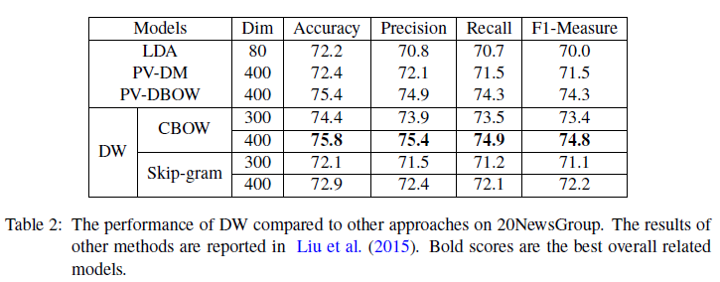
A Unified Learning Framework for Words and Attributes
Evaluation for Document Representations
Text Classification

Slide 30
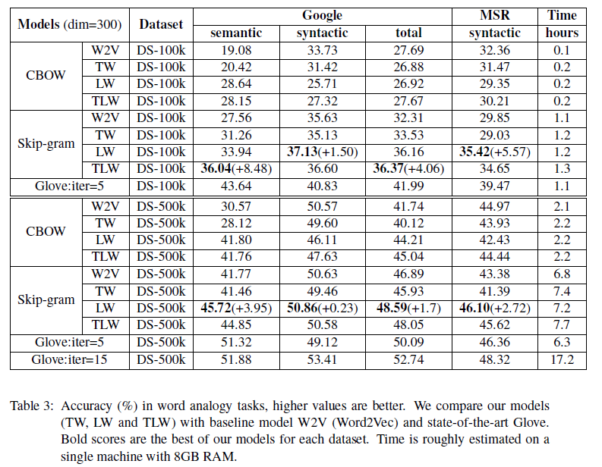
A Unified Learning Framework for Words and Attributes
Evaluation for Improved Word Representations
Word analogy

Slide 31
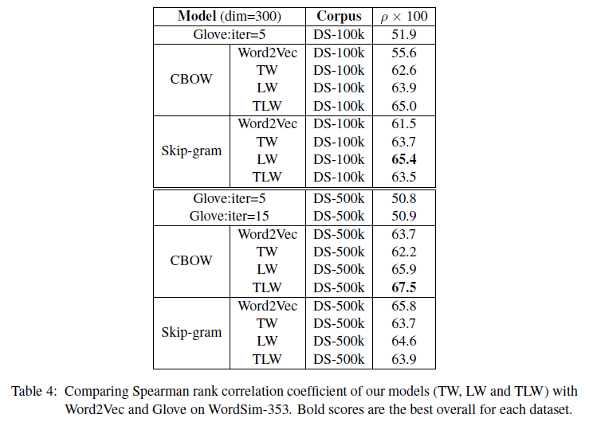
A Unified Learning Framework for Words and Attributes
Evaluation for Improved Word Representations
Word similarity

Slide 32
A Unified Learning Framework for Words and Attributes
Summary
We propose a unified framework for learning distributed representations of word and attributes.
Our models not only learn topic and document representations which achieve distinct and competitive results in corresponding tasks, but also improve original word representations significantly.
Our proposed framework is flexible and scalable.

Slide 33
Outline
Background
Related Work
Traditional text representations
Distributed representations
My Work
Motivations
Learning Distributed Representations of Topics
A Unified Learning Framework for Words and Attributes
Embedding Enhanced Topic Models
Conclusions
Reference

Slide 34
Embedding Enhanced Topic Models
Word embeddings
Unsupervised learning
Large-scale datasets
Syntactic and semantic information
Latent topic models
LDA models structure of words, topics, and documents
Gibbs sampling

Slide 35
Embedding Enhanced Topic Models
Integrating word2vec and LDA
Word embedding clustering prior LDA
Using external large-scale dataset
Context-aware LDA
Adding a latent variable
Word embedding enhanced LDA
Using word embedding during inference

Slide 36
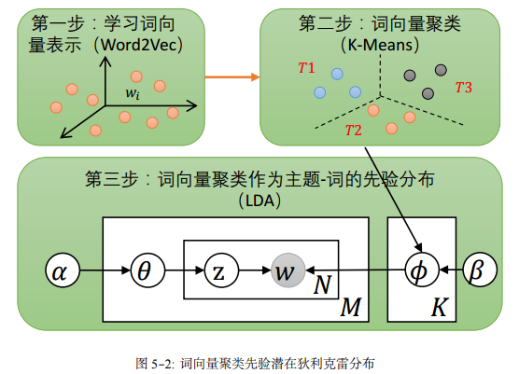
Embedding Enhanced Topic Models
Word embedding clustering prior LDA (wecpLDA)
Using external large-scale dataset

Slide 37
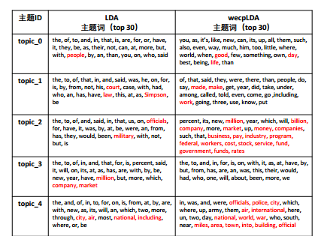
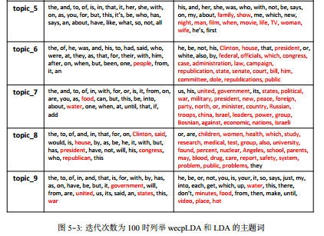
Embedding Enhanced Topic Models
Evaluation of Topic Coherence (noise data)

Slide 38
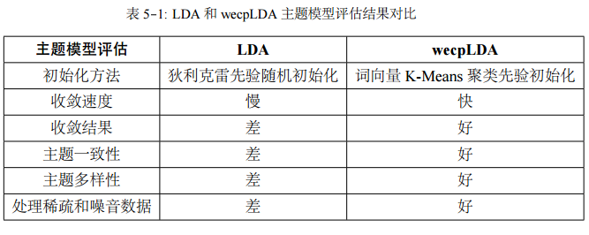
Embedding Enhanced Topic Models
Comparing wecpLDA with LDA
wecpLDA uses external knowledge

Slide 39
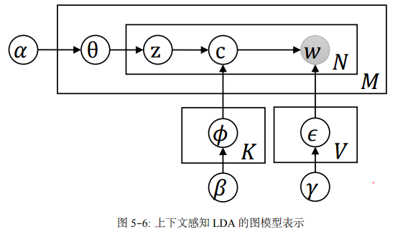
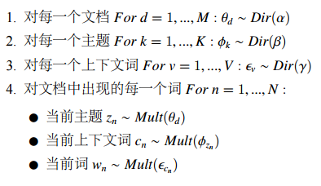

Embedding Enhanced Topic Models
Context-aware LDA (caLDA)
Adding a latent variable $c$

Slide 40





Embedding Enhanced Topic Models
Context-aware LDA (caLDA)
Gibbs sampling
Inference

Slide 41
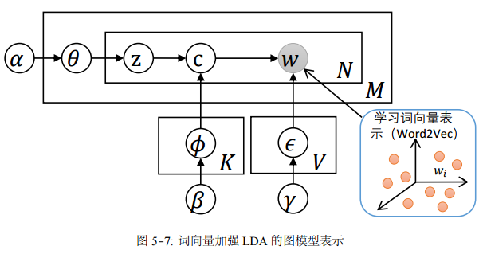
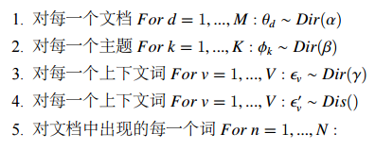
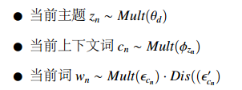
Embedding Enhanced Topic Models
Word embedding enhanced LDA (weeLDA)
Using word embedding during inference

Slide 42





Embedding Enhanced Topic Models
Word embedding enhanced LDA (weeLDA)
Gibbs sampling
Inference

Slide 43
Embedding Enhanced Topic Models
Summary
Word embedding clustering prior LDA
wecpLDA performed better than LDA
Context-aware LDA
Implementation and experiments
Word embedding enhanced LDA (weeLDA)
Implementation and experiments
Explore more
Bayesian deep learning
Denoising auto-encoders

Slide 44
Outline
Background
Related Work
Traditional text representations
Distributed representations
My Work
Motivations
Learning Distributed Representations of Topics
A Unified Learning Framework for Words and Attributes
Embedding Enhanced Topic Models
Conclusions
Reference

Slide 45
Conclusions
Focus on text representations and modeling in NLP
Importance of representations
Related methods
Our methods
Learning Distributed Representations of Topics
A Unified Learning Framework for Words and Attributes
Embedding Enhanced Topic Models
Future work
Exploring integration of deep learning and Bayesian models for AI systems

Slide 46
Outline
Background
Related Work
Traditional text representations
Distributed representations
My Work
Motivations
Learning Distributed Representations of Topics
A Unified Learning Framework for Words and Attributes
Embedding Enhanced Topic Models
Conclusions
Reference

Slide 47
Reference
LeCun, Y., Bengio, Y. and Hinton, G. E. (2015) Deep Learning, Nature, Vol. 521, pp 436-444. http://www.cs.toronto.edu/~hinton/absps/NatureDeepReview.pdf
Artificial Intelligence A Modern Approach http://www.cin.ufpe.br/~tfl2/artificial-intelligence-modern-approach.9780131038059.25368.pdf
Deep Learning for NLP http://nlp.stanford.edu/courses/NAACL2013/NAACL2013-Socher-Manning-DeepLearning.pdf
Word representations: A simple and general method for semi-supervised learning http://www.aclweb.org/anthology/P10-1040
Towards Bayesian Deep Learning: A Survey http://arxiv.org/pdf/1604.01662v2.pdf
An Introduction to MCMC for Machine Learning http://www.cs.ubc.ca/~arnaud/andrieu_defreitas_doucet_jordan_intromontecarlomachinelearning.pdf
Information Theory, Inference, and Learning Algorithms http://www.inference.phy.cam.ac.uk/itprnn/book.pdf
Yittoo http://139.129.37.204/niuwp/index.php/category/resources/
Machine learning a probabilistic perspective
A New Look at the System, Algorithm and Theory Foundations of Distributed Machine Learning http://petuum.github.io/papers/SysAlgTheoryKDD2015.pdf
Pattern Recognition and Machine Learning

Slide 48
Thank you!

